Slide 1
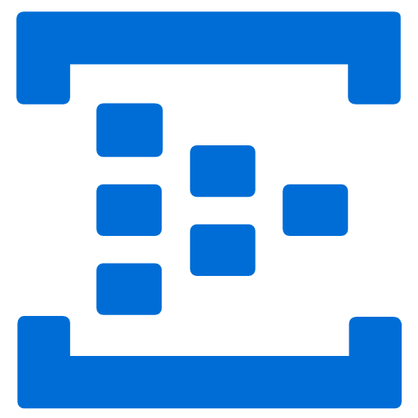
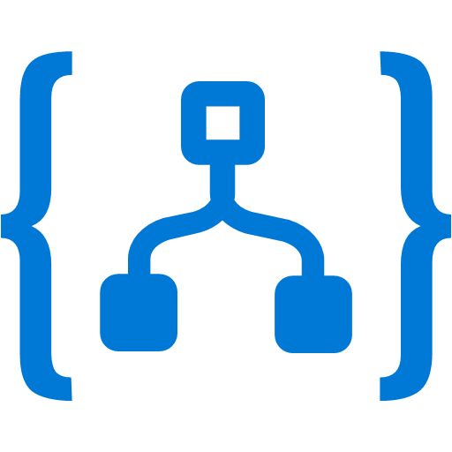
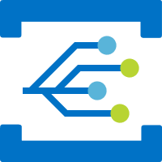
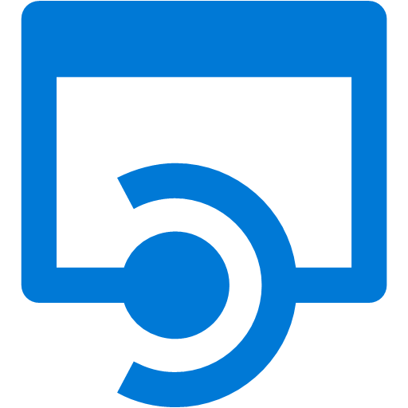
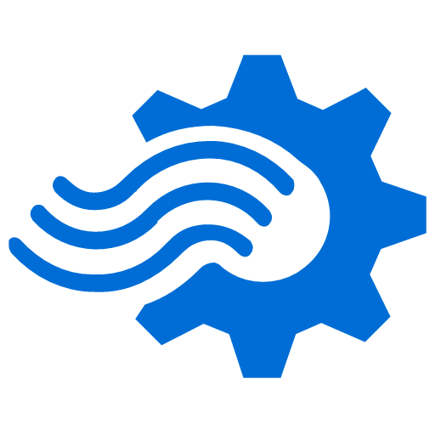
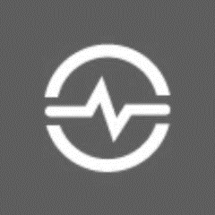
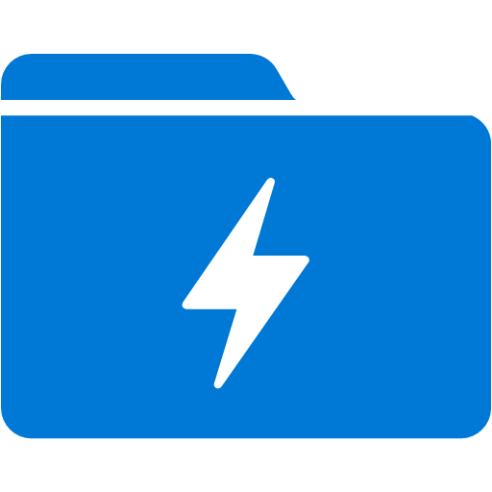

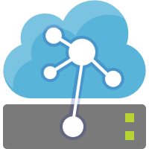
Notifications
Notifications
Event Hub
Notifications
Logic Apps
Notifications
Event Grid
Alerts
Alerts
Event Hub
Alerts
Logic Apps
Alerts
Event Grid
Alerts
opcPlc-7038af8
Telemetry
Telemetry
OPC Publisher
Stream Analytics
OPC Translator
IoT Hub
Stream Analytics
Telemetry
Event Hub
Time Series
Insights
opcPlc-c47ec19f
Aggregated
Telemetry
Azure IoT Edge
Data Lake
Store
Data Explorer
Notes:
https://docs.microsoft.com/en-us/azure/architecture/reference-architectures/iot/
Keith:
In order to start talking about the solution that we described above, we first have to start with our Cloud Gateway, the IoT Hub. The IoT Hub is the center of any modern IoT architecture as it provides secure connectivity, Event ingestion, bidirectional communication and device management at scale. Standing up a new IoT Hub is easy from the Azure Portal, or you can use ARM templets or Azure CLI.
Once we have an IoT Hub stood up we can then connect IoT Devices and IoT Edge Devices for data ingestion. Lets take a look at the Azure portal and the IoT Hub.

Slide 2
OPC Publisher
Stream Analytics
alertsoutput
opc
streaminput
OPC Translator
telemetryoutput
opc
dtdl
$upstream

